Slide 1
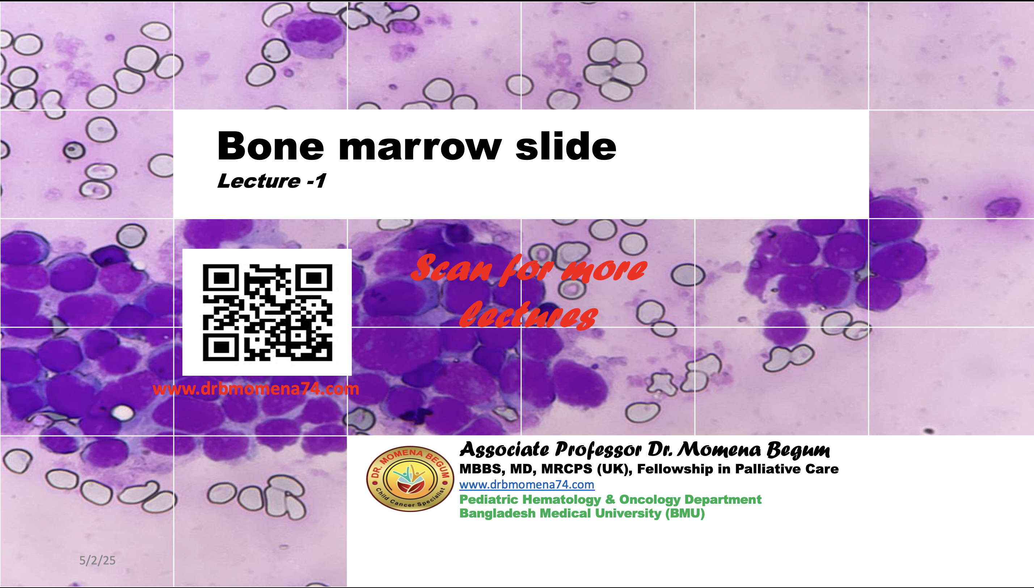
https://docs.google.com/presentation/d/19aJlWaWHWilpja9bq5ivzL89zRVt71zo/edit?usp=sharing&ouid=116395809512671210899&rtpof=true&sd=true

Slide 2
Normal Bone marrow
Components of bone marrow..............
  The cellular components of the marrow include haematopoietic cells and stromal cells.
  Haematopoietic cells include........
    Stem cells, maturing granulocytic/myeloid cells, erythroid cells, megakaryocytes, lymphocytes and plasma cells.
  Stromal cells include........
    Adipocytes, fibroblasts, dendritic cells and macrophages.

Slide 3
For Bone marrow study……..
Peripheral blood (CBC & PBF)
Bone marrow aspiration
Trephine biopsy
Notes:
Bone marrow study need

Slide 4
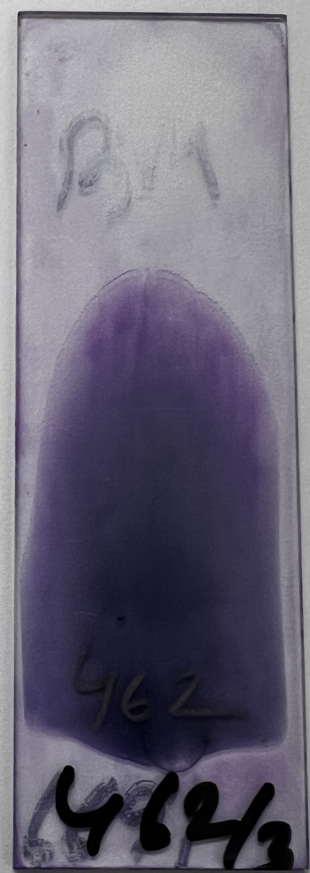
Peripheral blood
Stained : Leishman
PBF for the assessment of ……..
  Overall Cellularity (Cytopenia/Normal/ Increased)
  WBC- Leukocyte distribution & morphology
  RBC- Morphology
  Platelet- Morphology
  Abnormal populations: Circulating blast or other atypical cells

Slide 5
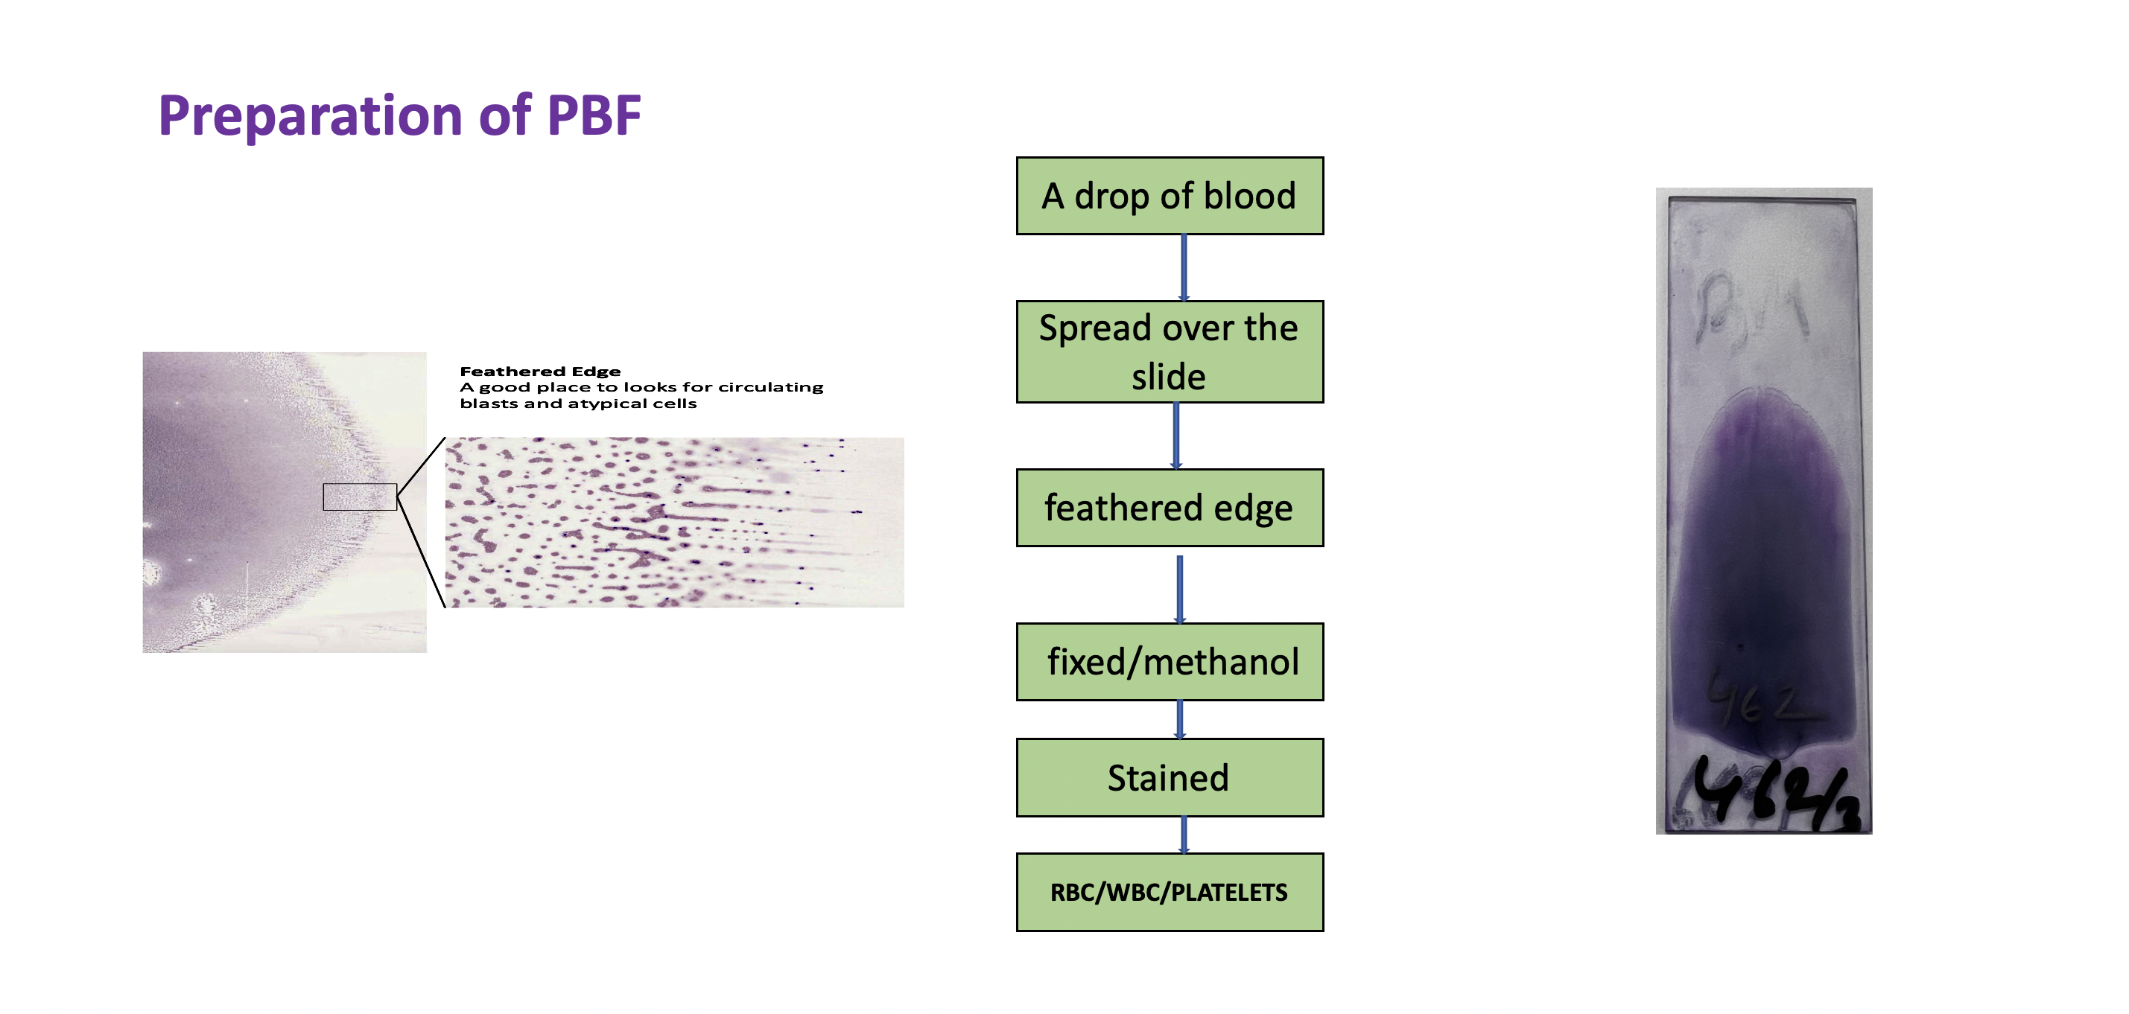

Slide 6
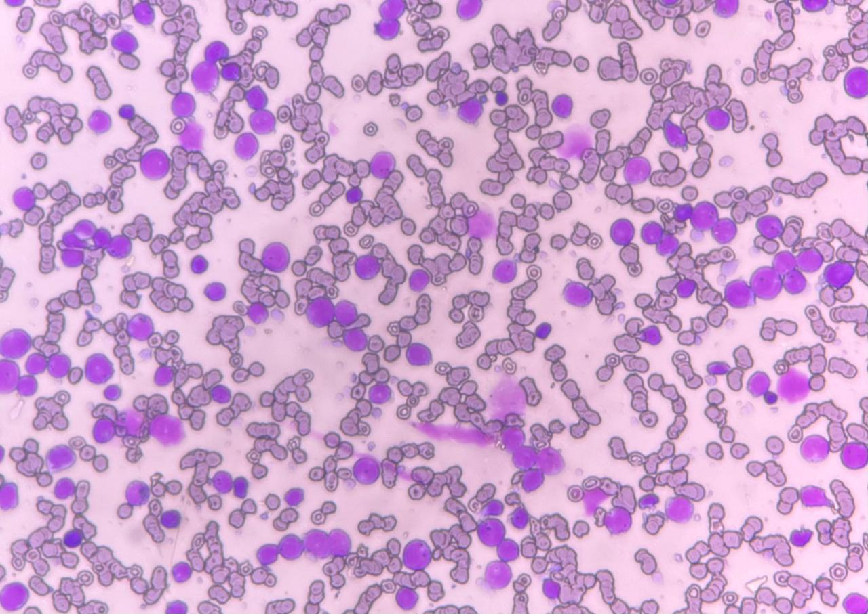
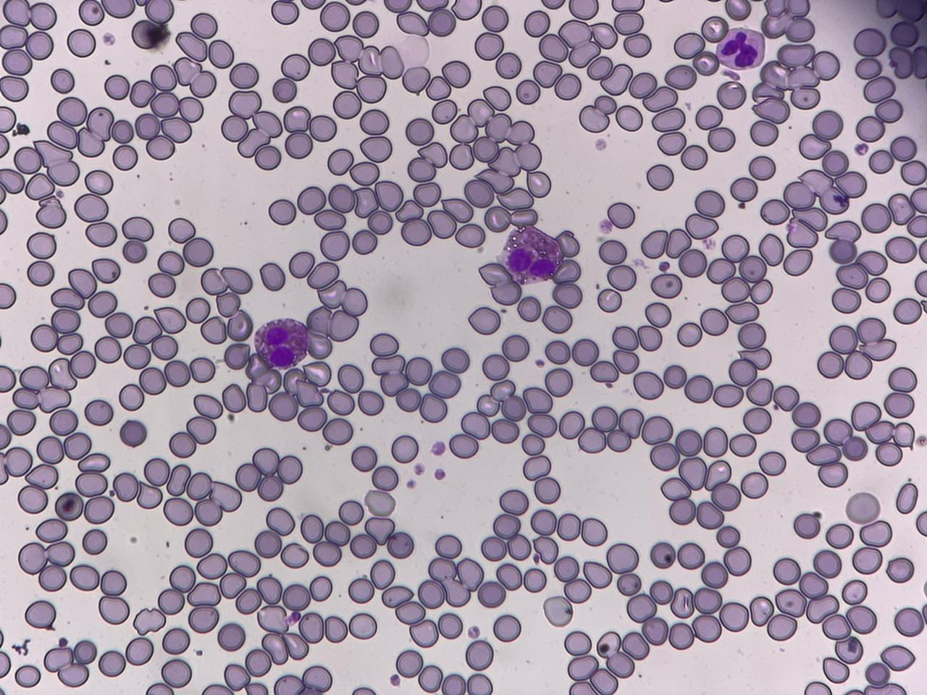
PBF
Increased Cellularity
Normal

Slide 7
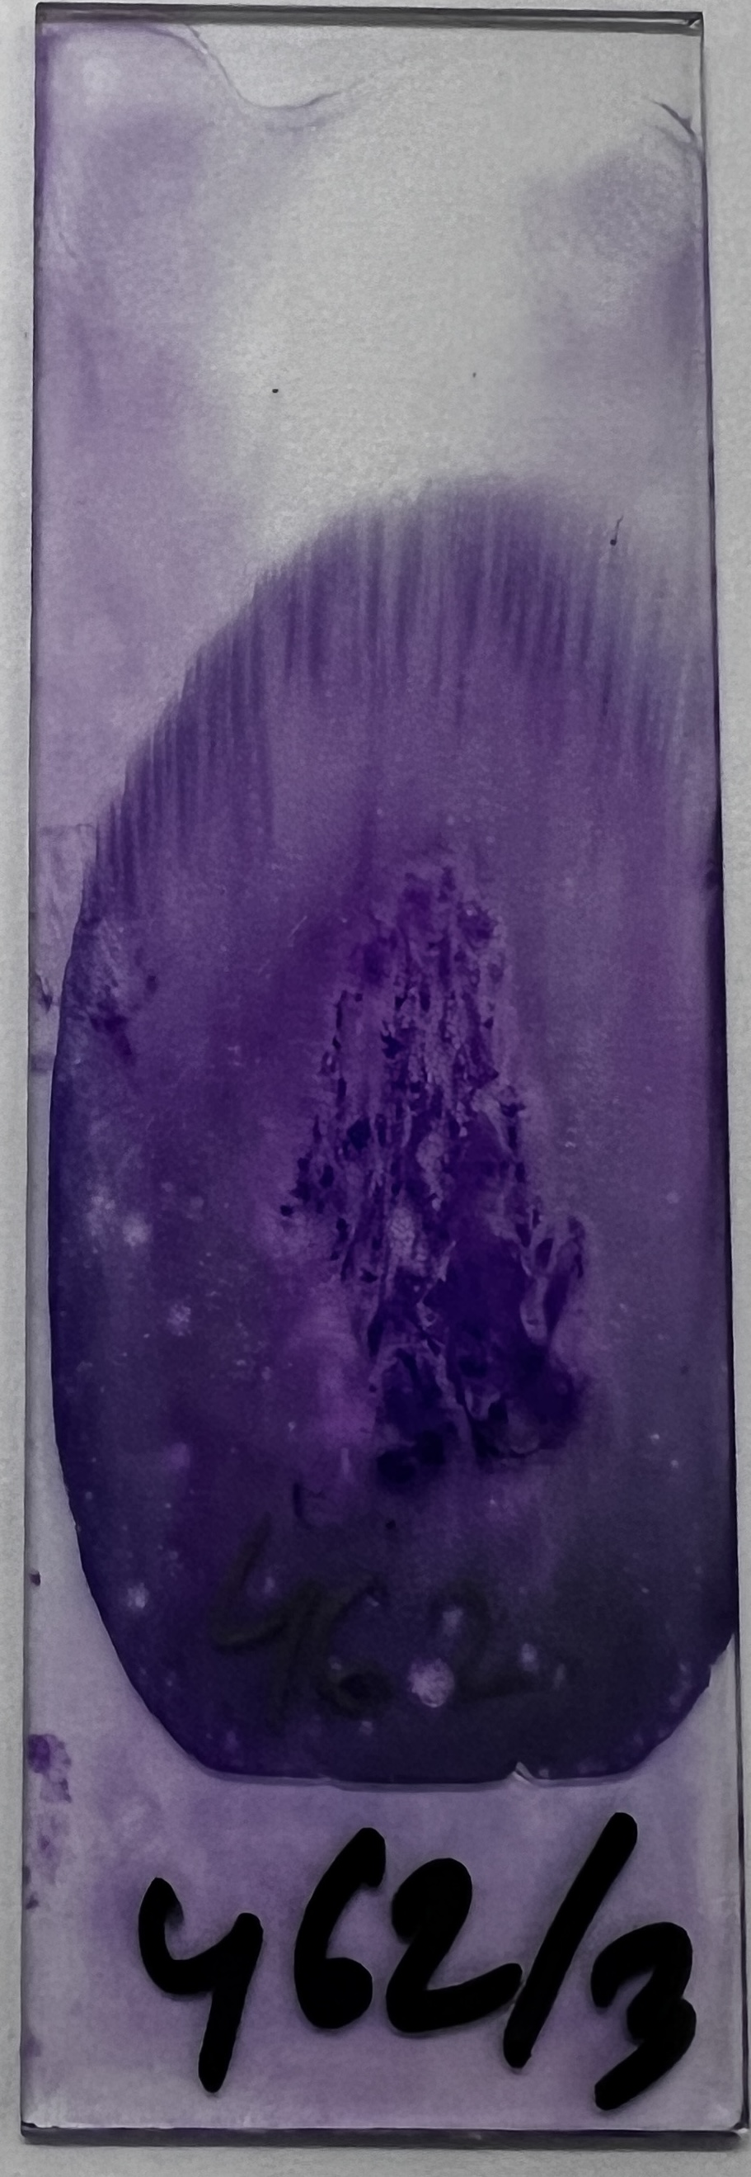
Bone marrow aspiration
Satisfactory samples can usually be aspirated from the…….
  Posterior iliac spine
  Tibia

Slide 8

Bone marrow aspirate ……
Stained: Leishman’s stain
Bonemarrow morphology used for assessment of :
  Cellularity (hypo, normo, hyper)
  Presence of trilineage hematopoiesis and maturation
  Myeloids, erythroids, and megakaryocytes
  Morphology
  Myeloids, erythroids, Megakaryocytes, lymphocytes, Plasma cells, Blasts
  Abnormal populations
  Myeloid to erythroid ratio

Slide 9
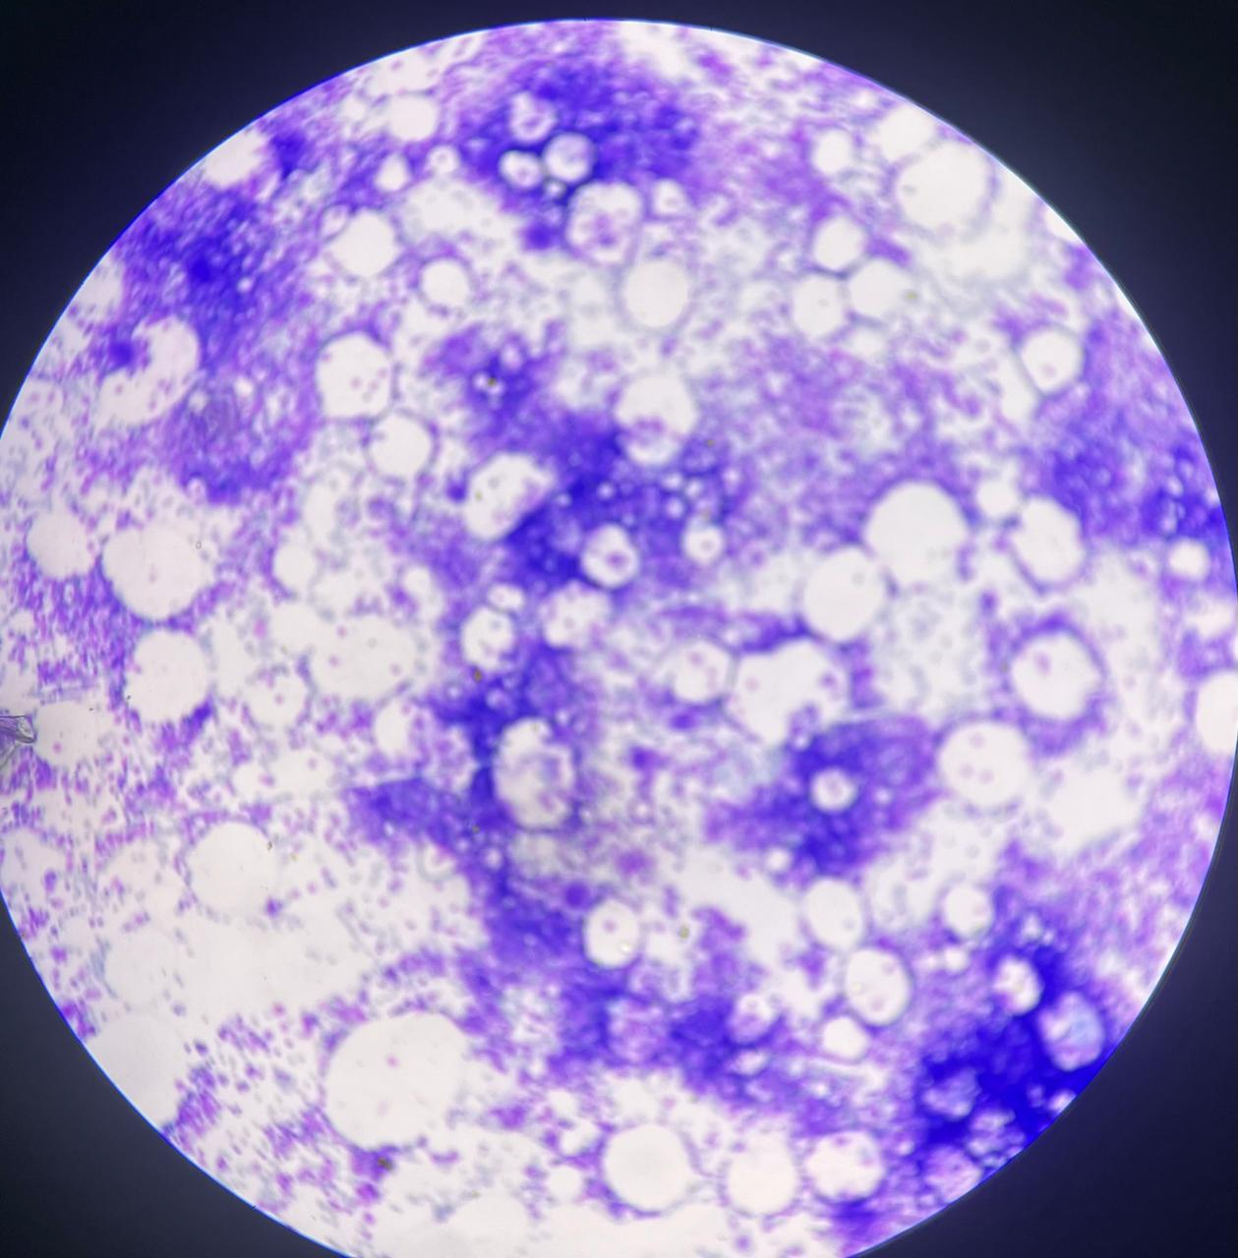
Bone marrow slide in low power
Low Power:
Bony spicules
Cellularity
Megakaryocytes

Slide 10
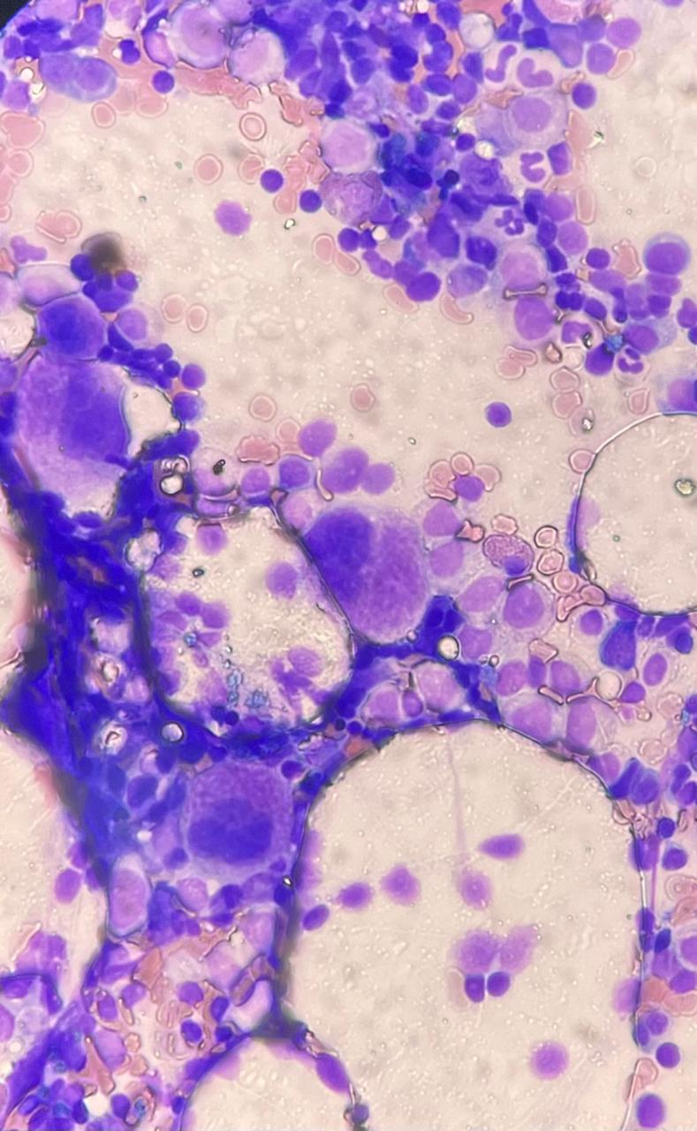
Bone marrow slide in medium to high power
Medium to high Power:
Cellularity
Cellular morphology
Megakaryocytes

Slide 11
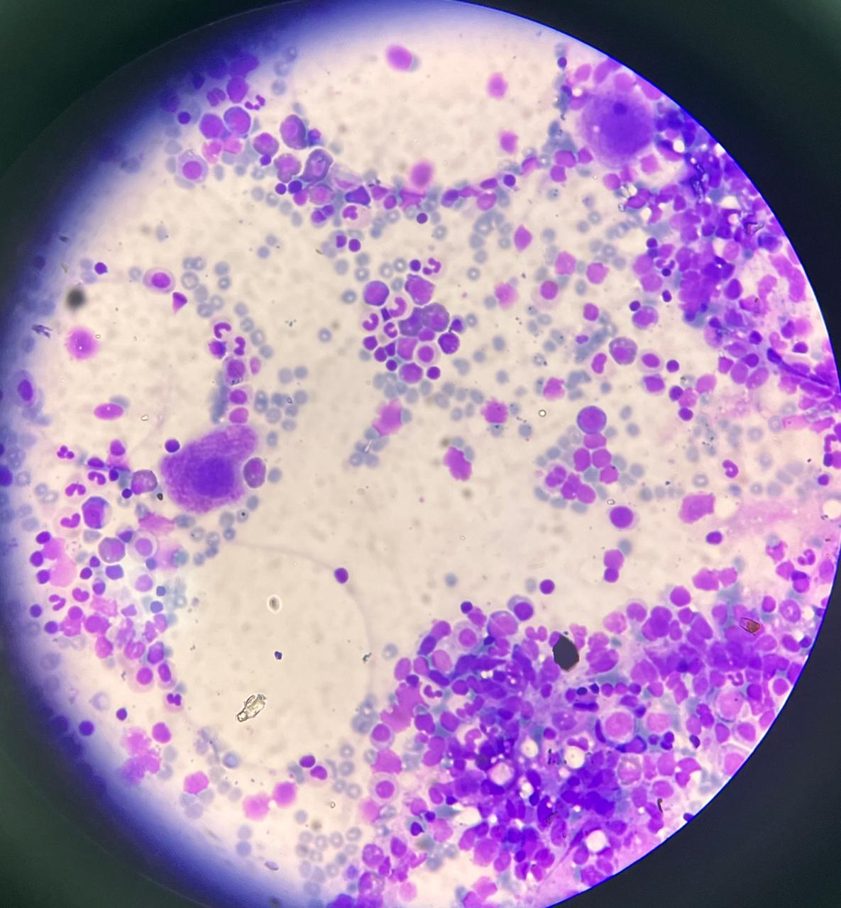
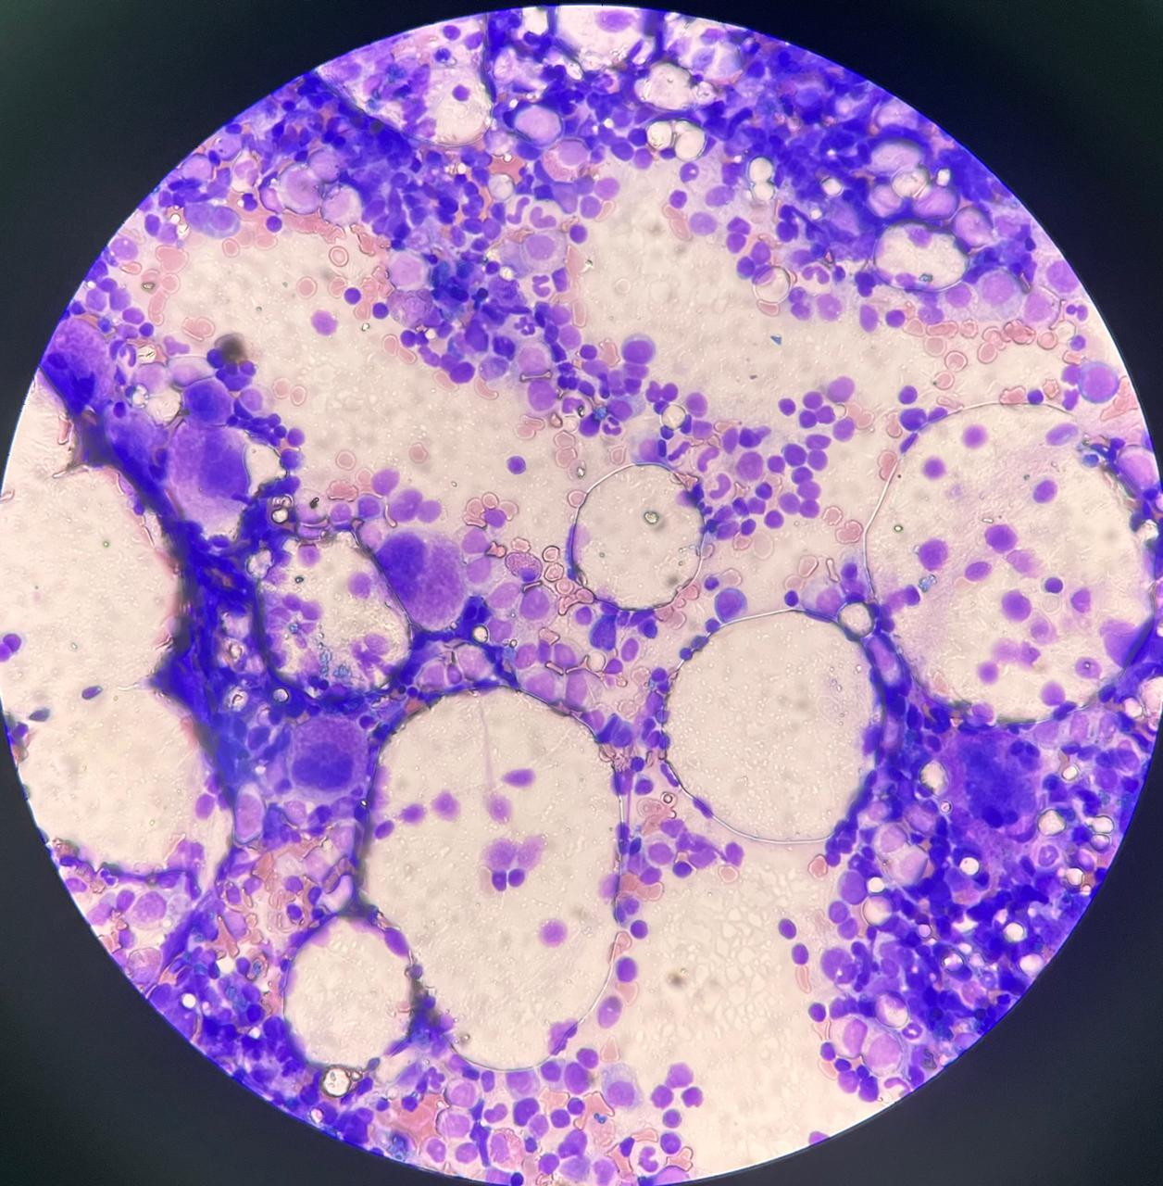
Bone marrow slide in medium to high power

Slide 12
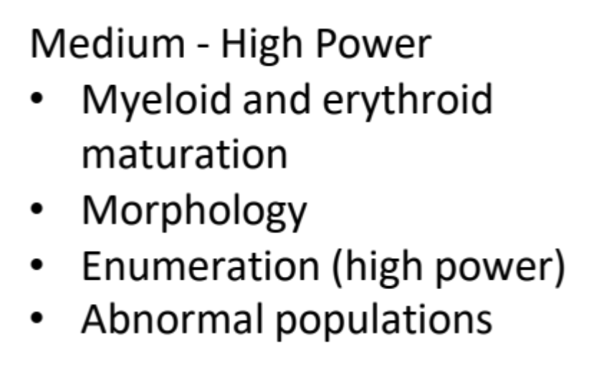

Slide 13
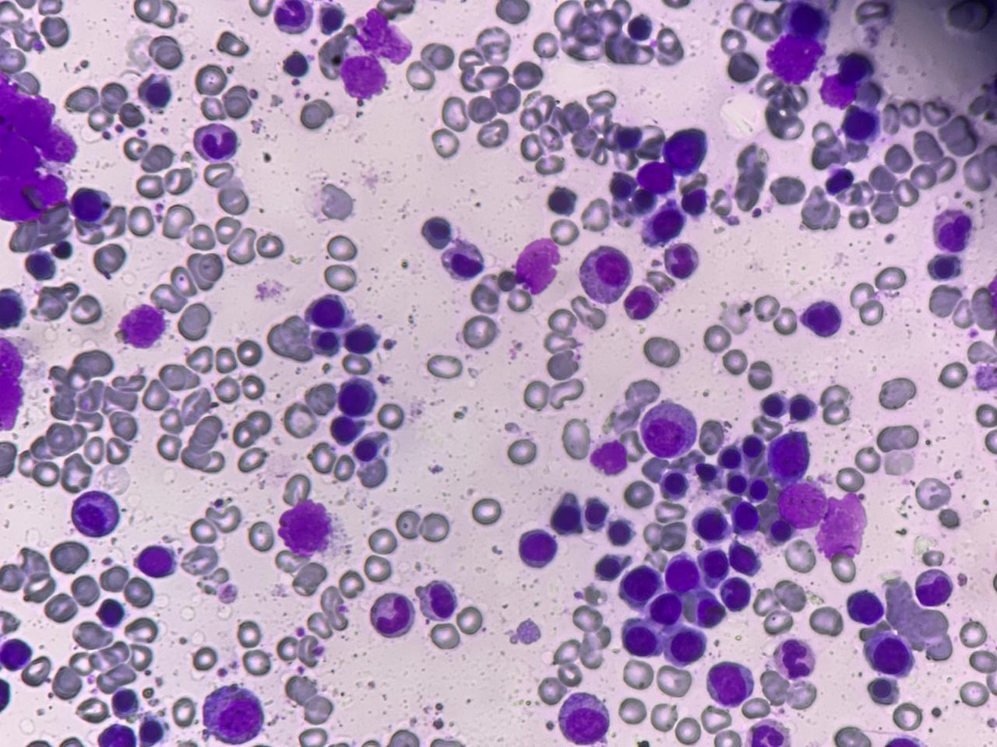
Cells of erythroid lineage

Slide 14
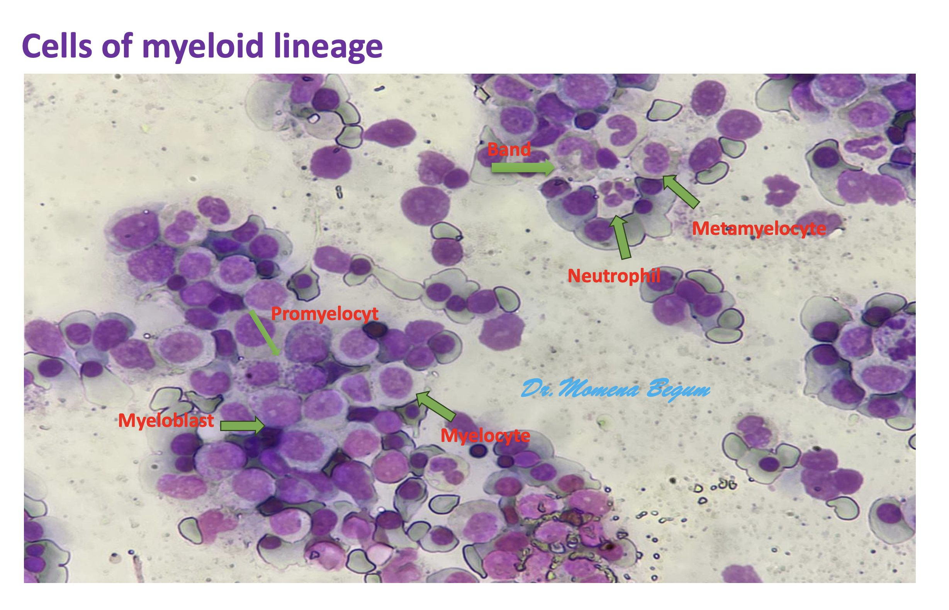

Slide 15
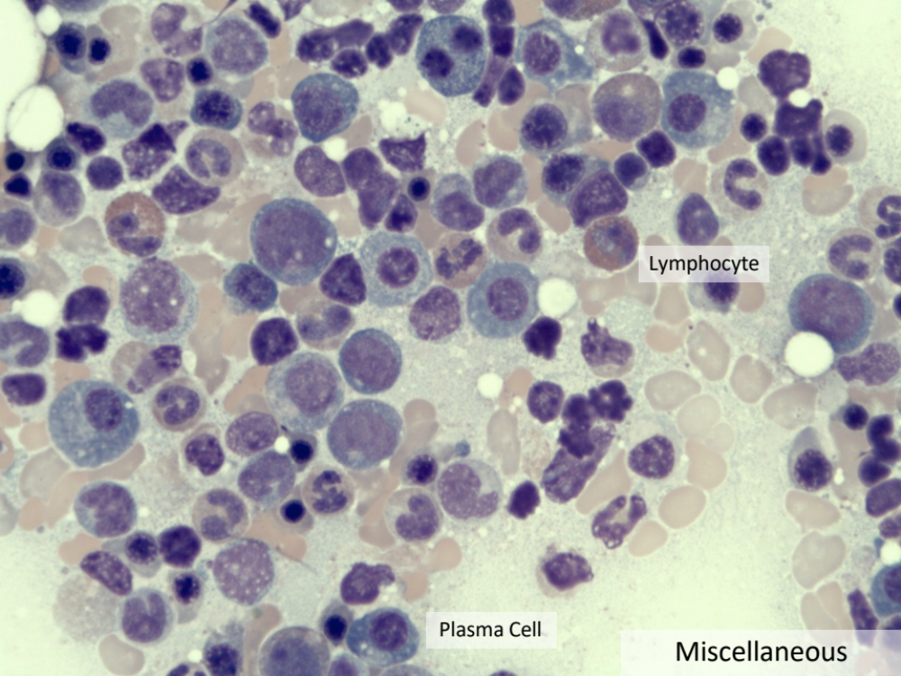
Cells of lymphoid origin

Slide 16
Bone marrow Aspirate Smears Summary
Low Power
Rough estimate of cellularity
Identify megakaryocytes and assess morphology
Overtly abnormal populations
Medium to High Power
Assess myeloid and erythroid maturation and morphology
Identify abnormal populations that are more subtle

Slide 17
Questions
and answers

Slide 18
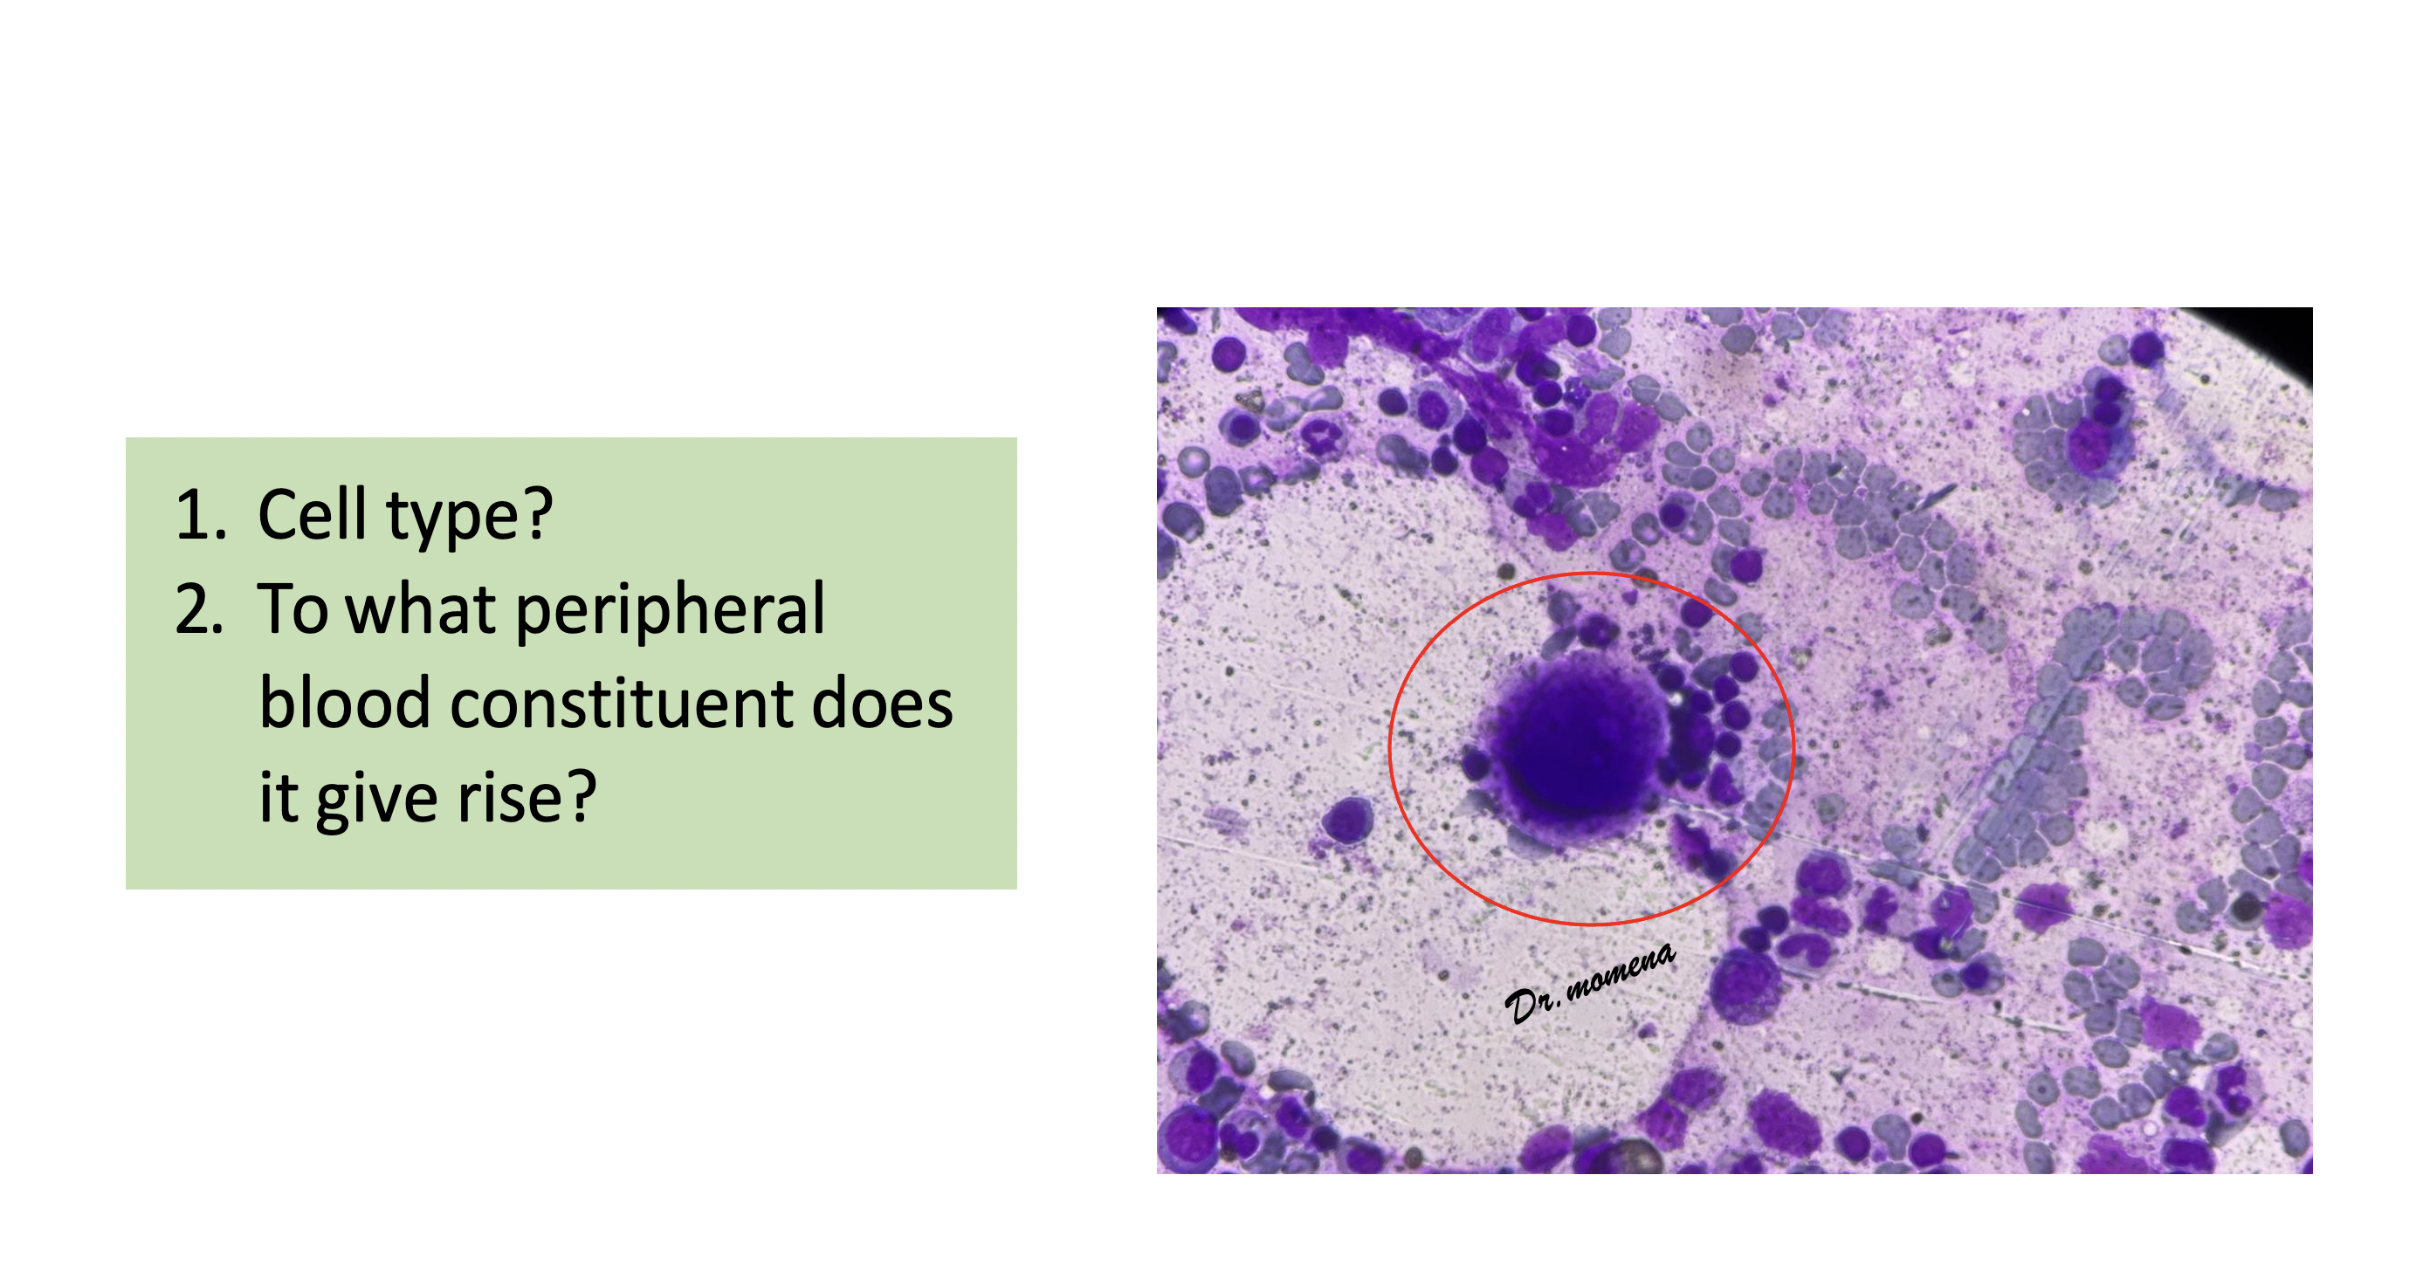

Slide 19
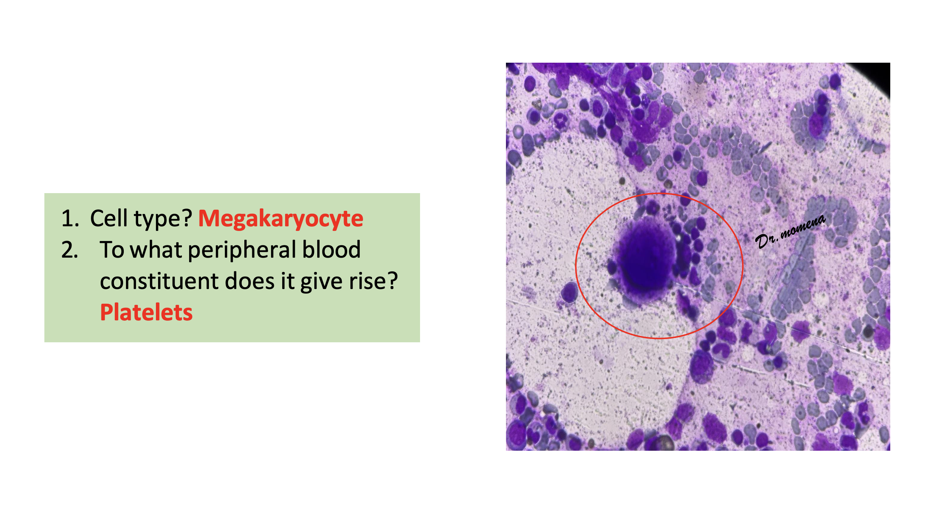

Slide 20
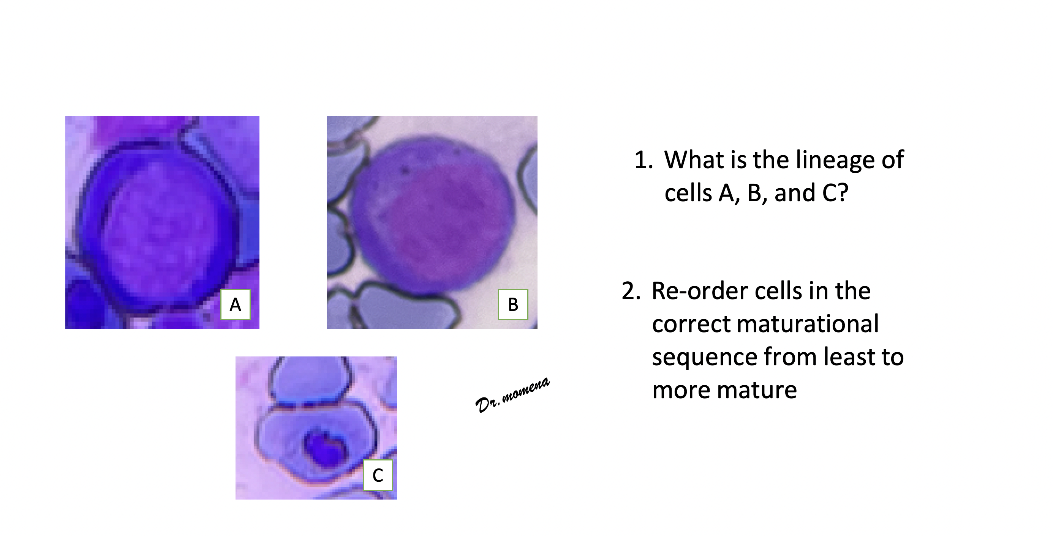

Slide 21
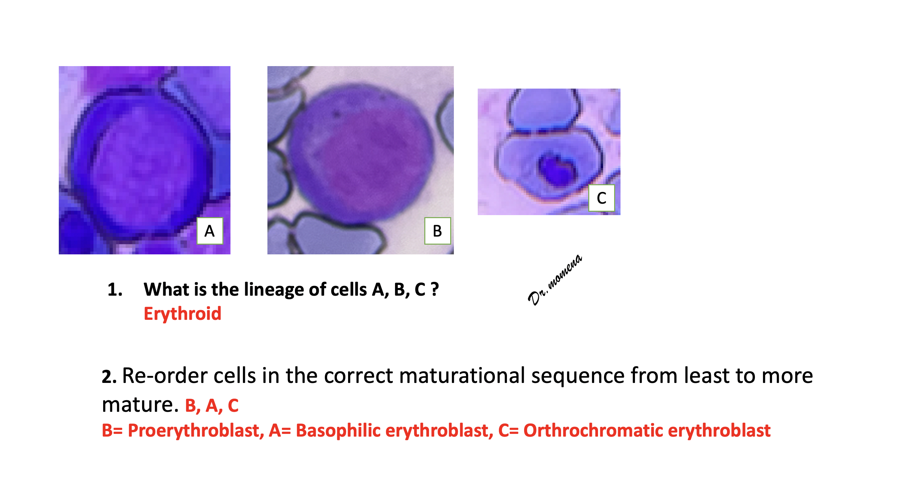

Slide 22
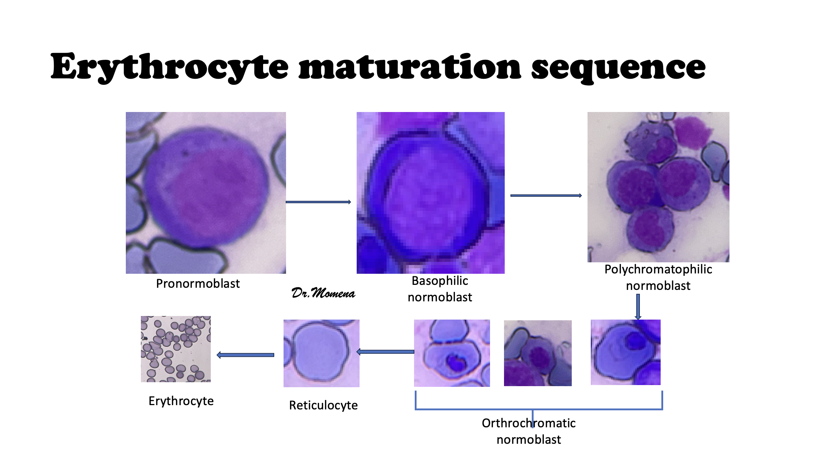

Slide 23
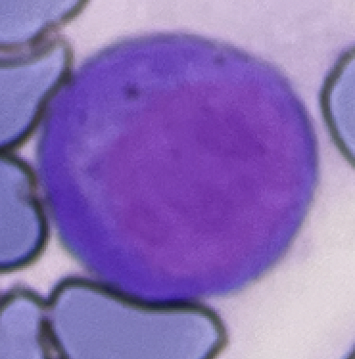

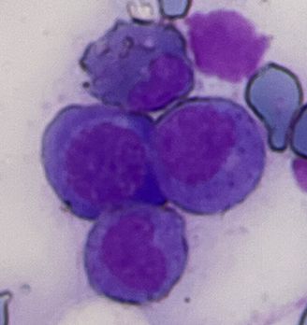
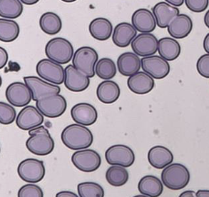

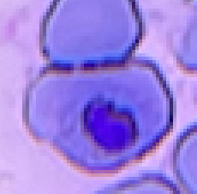
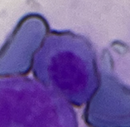

Erythrocyte maturation sequence
Pronormoblast
Basophilic normoblast
Polychromatophilic normoblast
Dr.Momena
Erythrocyte
Reticulocyte
Orthrochromatic normoblast

Slide 24
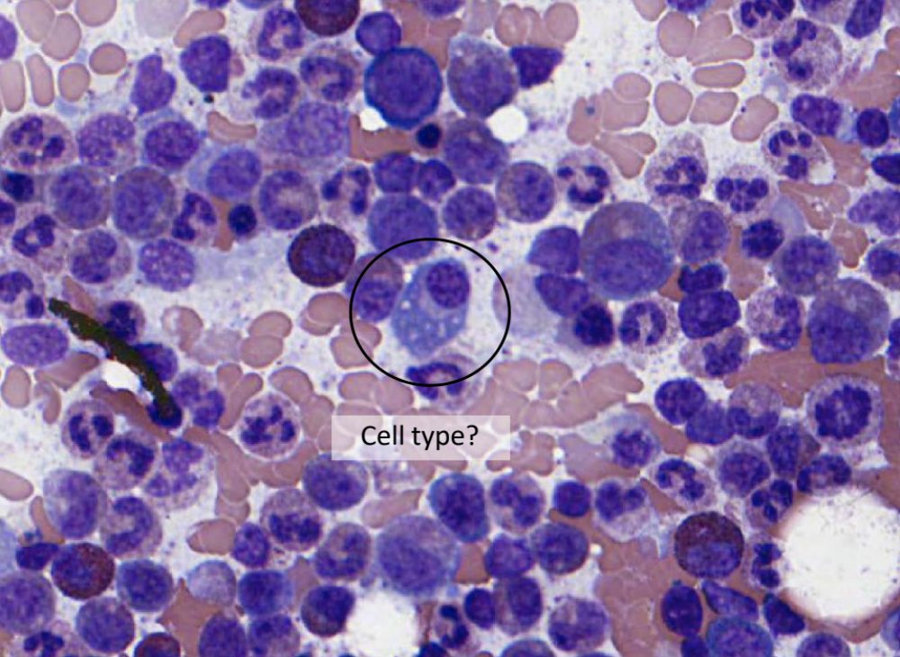


Slide 25
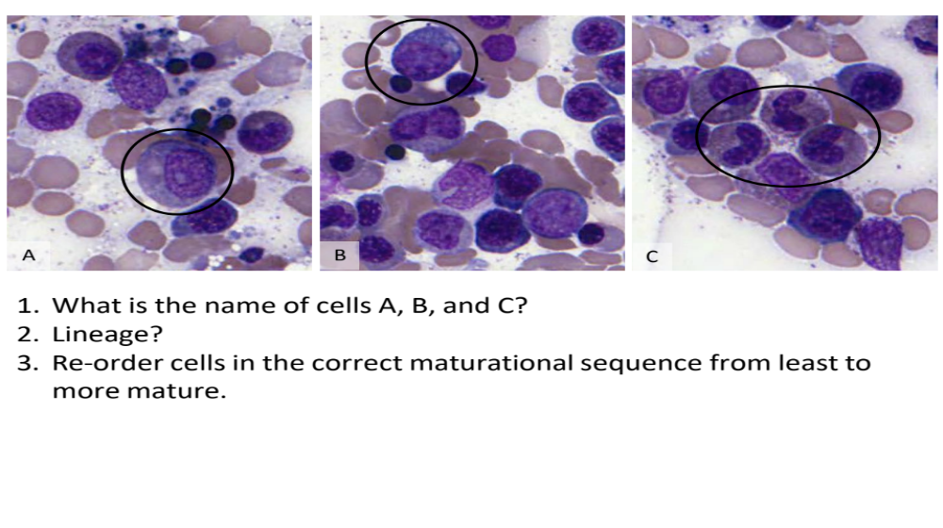

Slide 26
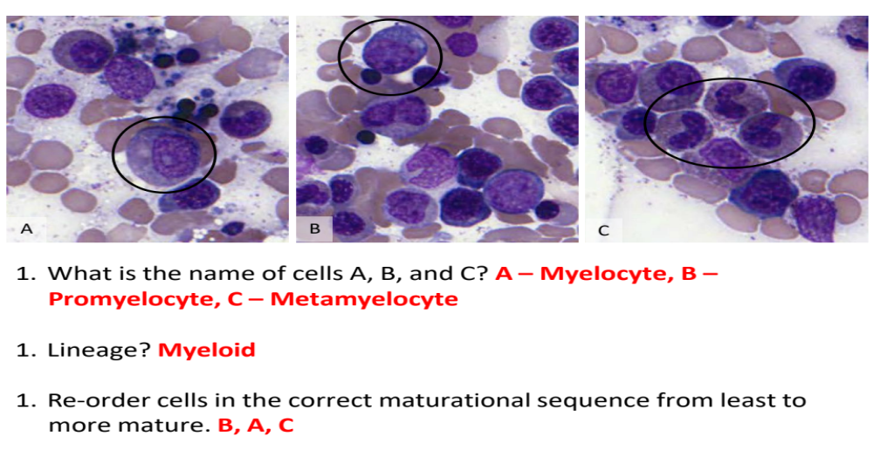

Slide 27
Summary
In general, a bone marrow study is composed of the following complementary components:
    Peripheral blood
    Aspiration smear
    Core biopsy
The three hematopoietic lineages are myeloid, erythroid, and megakaryocytes
Knowledge of normal marrow morphology, distribution, and maturational sequence is important for identifying abnormalities.

Slide 28


